Slide 1


(Global - Material Control System)
G-MCS an Overview

Slide 2
G-MCS Introduction
The system aims to compute the material requirement based on Production Schedule provided by PPS. This leads to optimum material inventory levels at all times, thereby reducing the production cost.
One of the key features in the production of Wiring Harness is the on-time availability of required Materials at the Production Floor. G-MCS helps in recognizing Material requirement and their future usage.
GMCS system covers the operations from customer order (in terms of MPS) to supplying the product.

Slide 3

G-MCS Capabilities
reduced inventory
reduced WIP
shorter lead times
  not too early, not too late...
Only what is needed, nothing more...
To have only the right materials, parts and products in the
right place at the right time.

Slide 4
Minimum Hardware/Software recommendation
2.0 GHz processor
2.0 GB RAM (depends on the amount of MPS Data to be exploded during the MRP Calculations)
73 GB * 2 (Raid 1)
Windows 2000 Advance Server
MS SQL Server 2000

Slide 5
Software Feature
Multilingual User Interface
Multiple Date format support
Interface with G-BOM and Cutting & Crimping (C&C) System
Interface with Common DB
Search Combo Support on F1/ F5
Default Section
Excel/Text Output
Custom Purpose reports
Program Level Security Control

Slide 6
System Features - 1
Multi - Currency
Supplier Wise choice for separate PO(s) for Wire and Other materials
EDI through Text Import/Exports for Receive and Issue Informations
Real Time transfers to FTP
Safety Inventory Calculation
PO Division between the requirement PO & Safety PO
PO Amendment Facility
Multiple Exchange Rate Management
FIFO

Slide 7
System Features - 2
Operation with Real-time devices like Bar Code Reader, Handy Terminal
Label Printing for Cut-tube
WIP control with surplus
Control on Inspection of Materials
Factory wise GMCS feature control
Supplier wise and Supplier-Material wise Calendar Maintenance.
MRP Simulation on different Safety Inventory settings.

Slide 8
Main Functions
Planning (MPS Vs Inventory, Shortage)
Safety Inventory Ratio Calculations
Purchase of Materials (Issuing POs to the Suppliers)
Receipt of materials from suppliers (Realtime receipt / Barcode receipt / EDI receipt)
Issue of materials (Kit issue / Single issue / Barcode issue / Kanban issue / Handy Terminal issue)
Material Stocktaking
WIP Maintenance (Material)
Reporting (MIS / Finance / BOM)

Slide 9
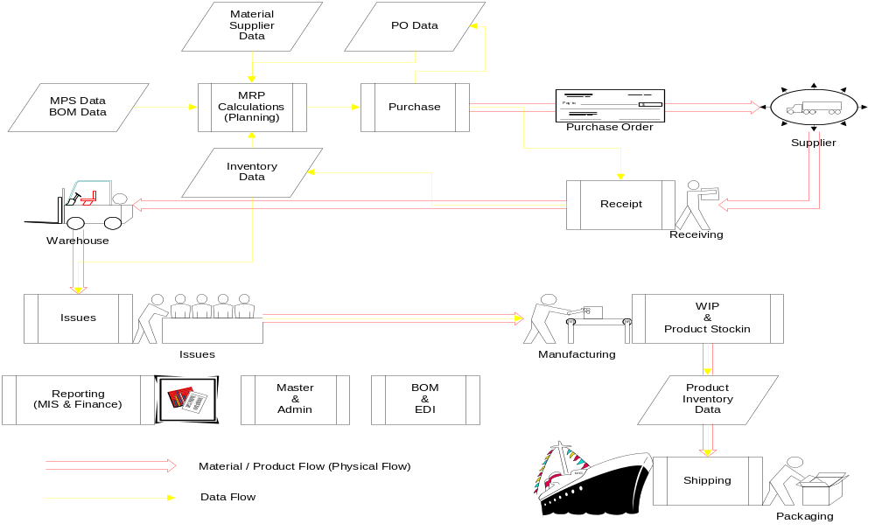

Information Flow

Slide 10
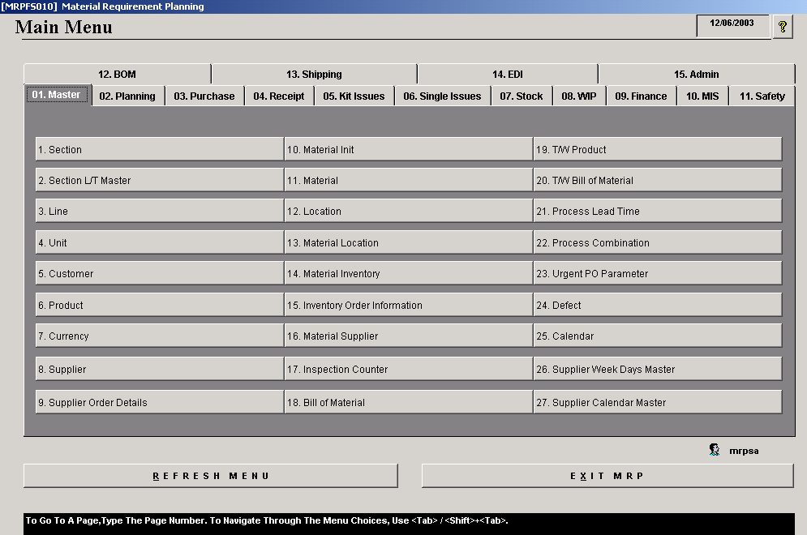
Main Menu

Slide 11
Masters Module
It consists of the data that does not change often.
These tables are populated at installation time although the user can change the data anytime.
The master module contains screens for Section, UOM, Material, Product, Supplier, Customer, Currency, Inventory, Material Supplier and Calendars etc.

Slide 12
Safety Module
Maintenance of Safety Inventory Calculation Parameters
Calculation of Safety inventory Ratio for each material
5 Methods to calculate Safety Inventory Ratio (Quantity, Structure Ratio, Product Count , Line Count and Requirement)
Safety inventory calculation comparisons

Slide 13
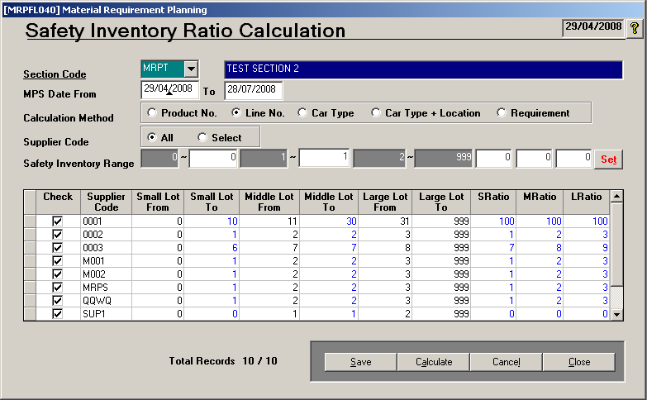
Safety Module …….… continue

Slide 14
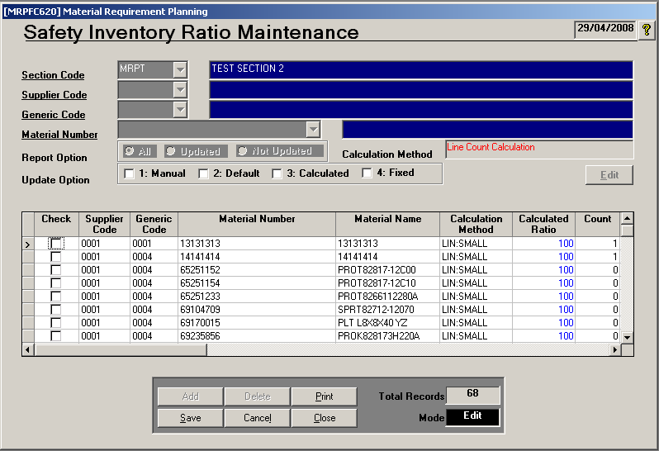
Safety Module ……… continue

Slide 15
Planning Module
Production Schedule maintenance.
Maintenance of Section, Supplier Order Calendar
MRP Calculation, Analysis of MRP Results.
Order Point Inventory and Inventory Order Calculation.
Release of MRP Suggested POs.
This module also contains few screens, which helps in trend analysis of historical MPS data for the change in production schedules and ABC analysis of inventory.

Slide 16
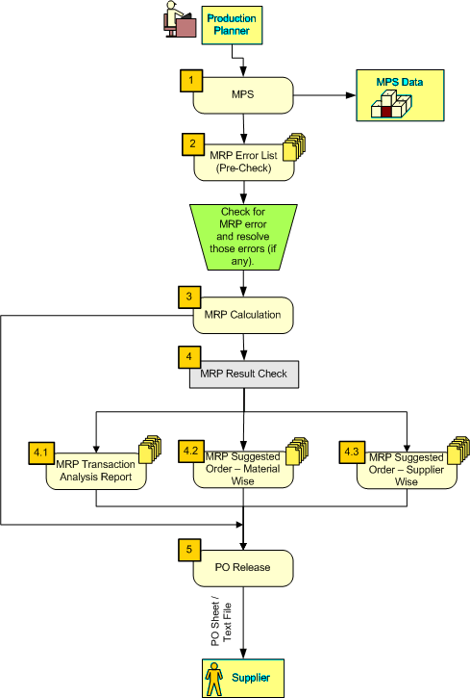
Planning / MRP FLOW

Slide 17
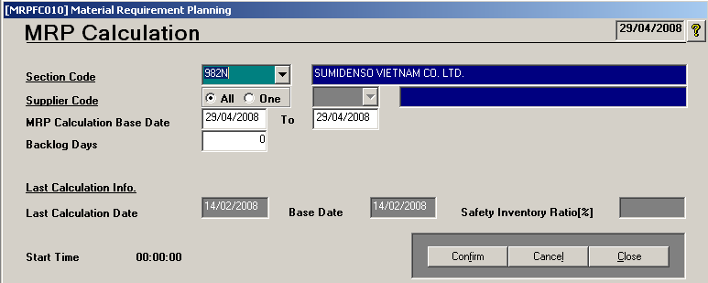
Planning Module ……… continue

Slide 18
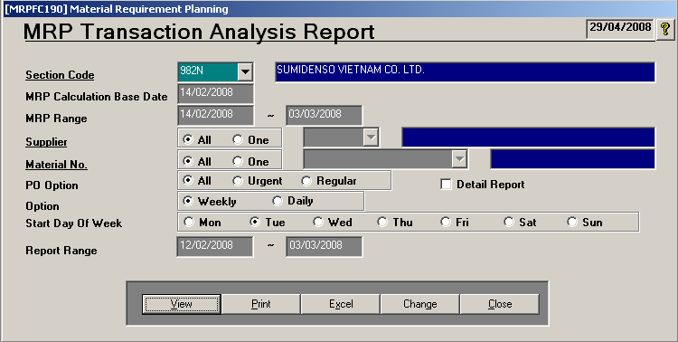
Planning Module ……… continue
Click on VIEW button to see the MRP Transaction Analysis Report

Slide 19
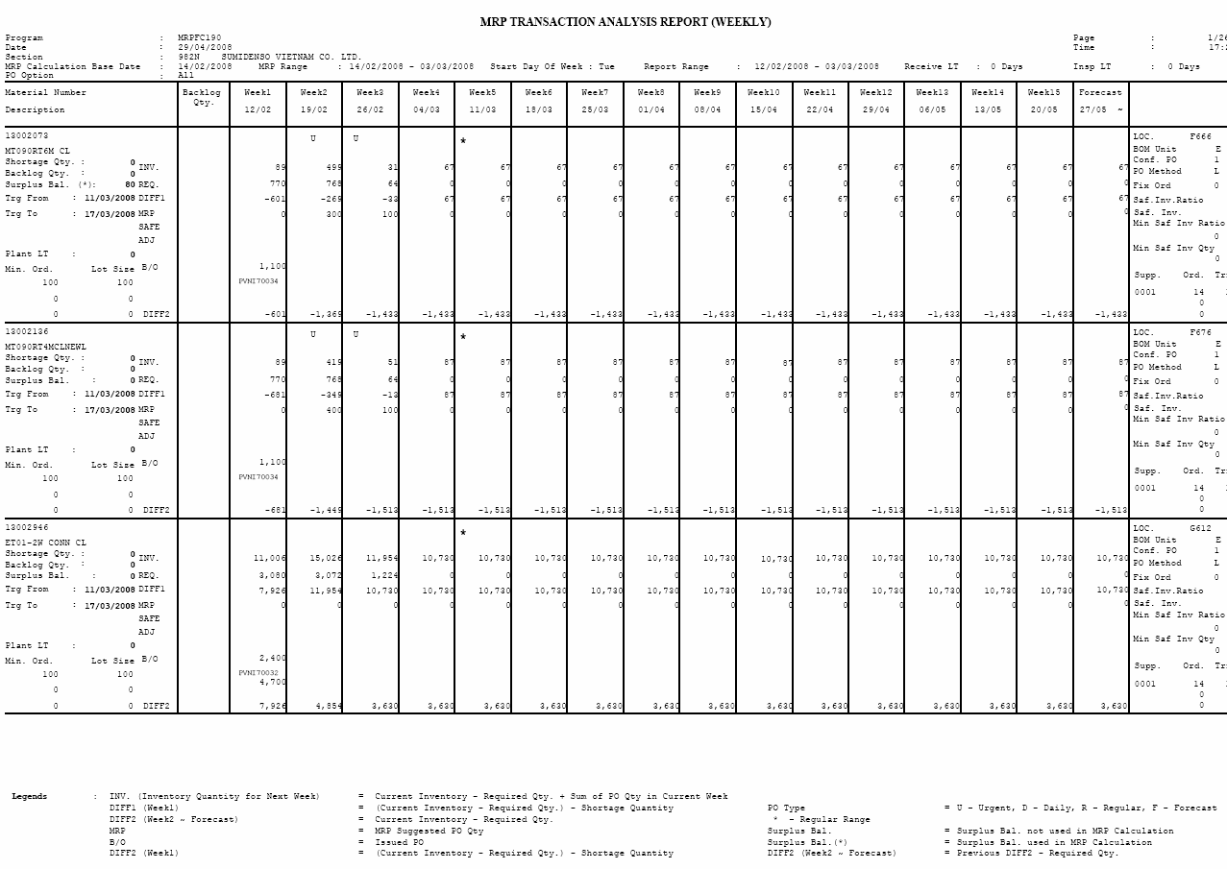
Planning Module ……… continue

Slide 20
Purchase Module
Create /Release POs, manually whenever required or on a daily basis.
Checking and Changing of PO Status.
Amendment of Issued PO.
PO Text File Creation for Supplier.
Reprint of Original, Combined or Last Amended Purchase Order.
PO Proof List

Slide 21
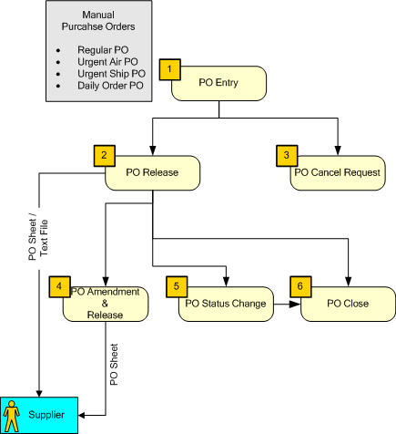
PURCHASE FLOW

Slide 22
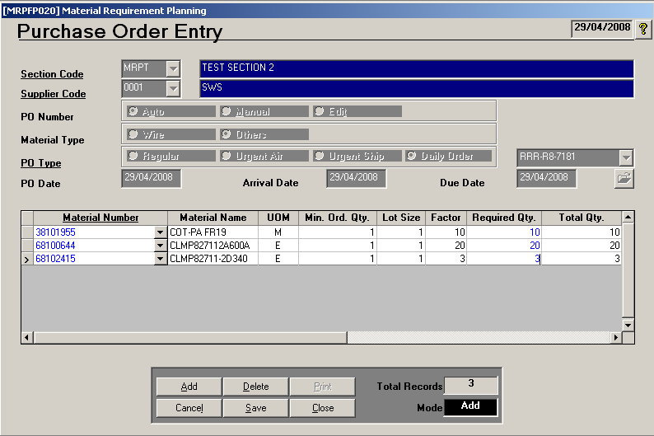
Purchase Module ……….Continue

Slide 23
Receipt Module
Receives materials from suppliers through this module.
Various screens for receipt, inspection and transfer of materials to the stores. Various Receipt/PO Comparison reports.
The materials can also be received through Barcode and HT Device.
Reports are generated enlisting the Supplier Quality and Performance based on actual arrival dates and material rejection ratio.
Prompt user to ask for Supplier Quality Report.

Slide 24
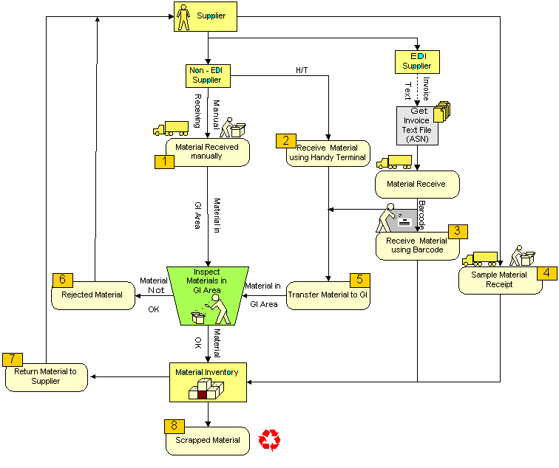
RECEIPT FLOW

Slide 25
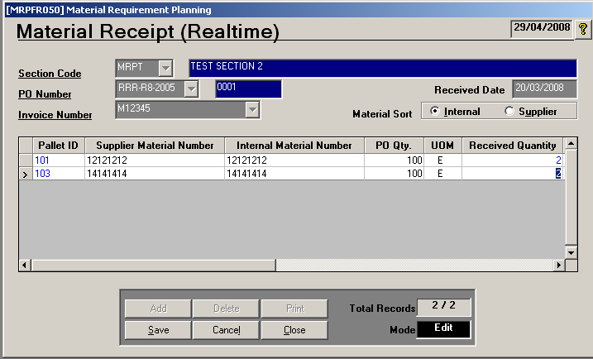
Receipt Module …….. Continue

Slide 26
Issues Module
Two modules exist for material issues, namely Kit Issues and Single Issues.
Issues are made in kits when all required material to manufacture a product is required to be issued at one time in kits.
Materials can also be issued on one by one basis through Single Issues.
Surplus is generated due to Issue Lot size
Generated Surplus is utilized on next issue requisition.
Actual Material issues can done using Barcode and HT Device.
Pick-List can be generated for Bar Code reader.
Reports like Pick list and Proof List are generated enlisting the materials issued through various channels.

Slide 27
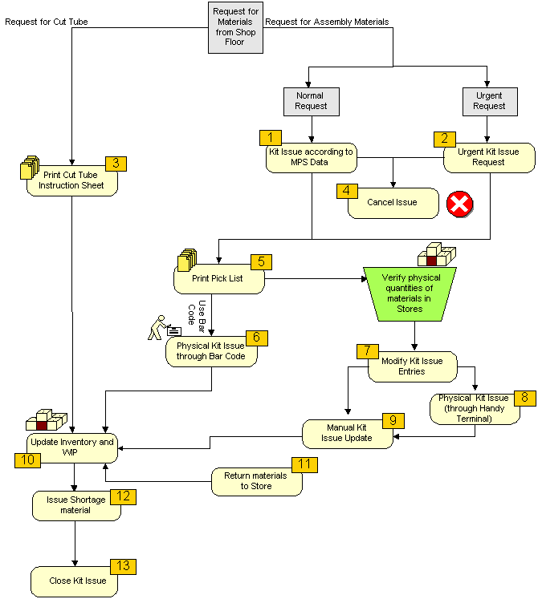
KI ISSUE FLOW

Slide 28
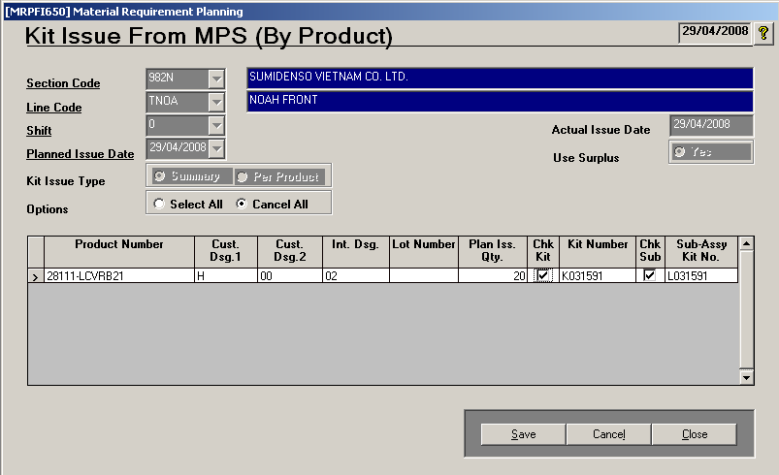
Issues Module ………..Continue

Slide 29
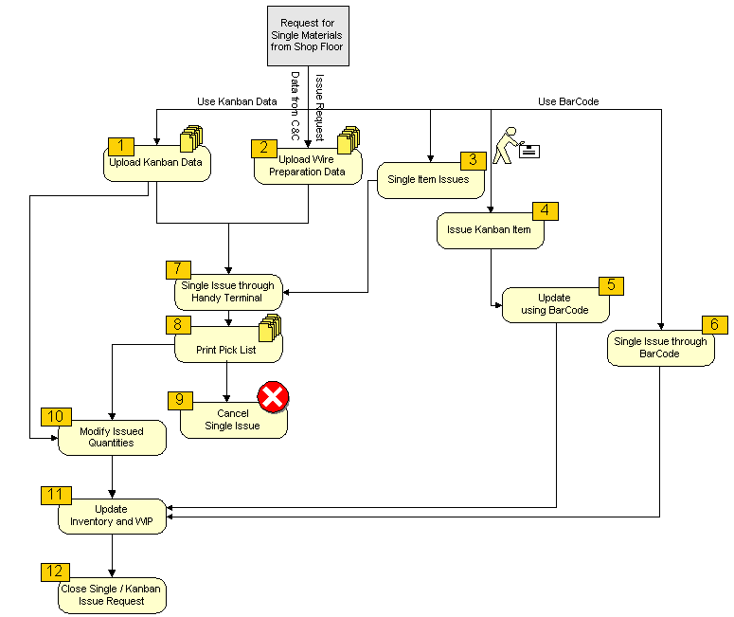
SINGLE ISSUE FLOW

Slide 30
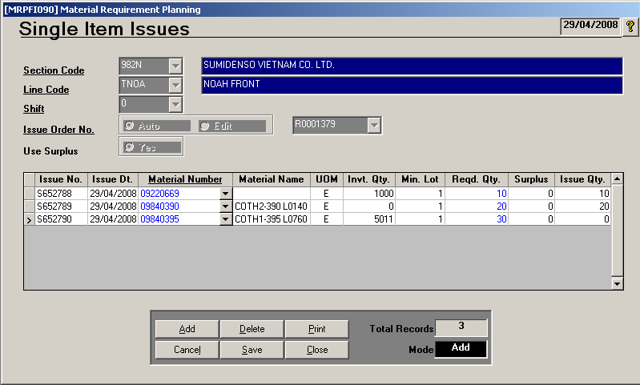
Issues Module ………..Continue

Slide 31
WIP Module
WIP is maintained through this module on a line-by-line basis.
Surplus on Line can be override from this module
Enables Use to Physical Count and Updating of Material Inventory on Production floor.
Physical WIP (Product / Material).
C&C Line WIP updating from C&C System
Demand and Issue Comparison Report

Slide 32
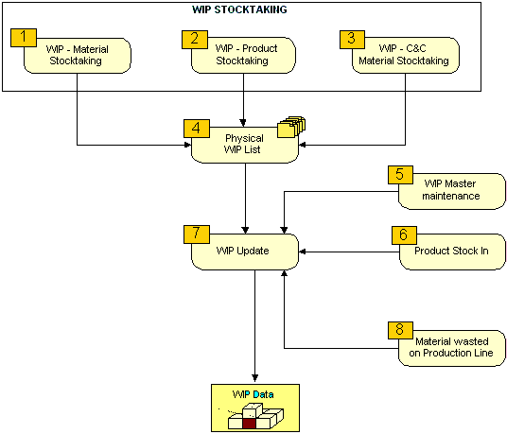
WIP FLOW

Slide 33
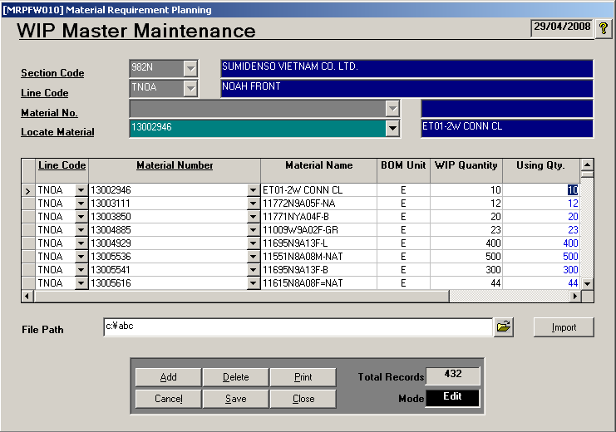
WIP Module……..Continue

Slide 34
Stock Taking Module
Stock Taking of Material lying in Stores.
Physical Cycle Counting Performance summary report for Materials.

Slide 35
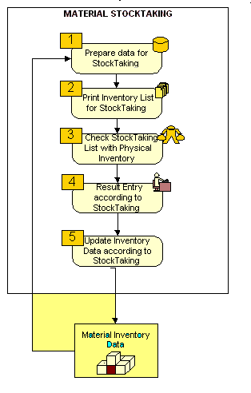
STOCK TAKING FLOW

Slide 36
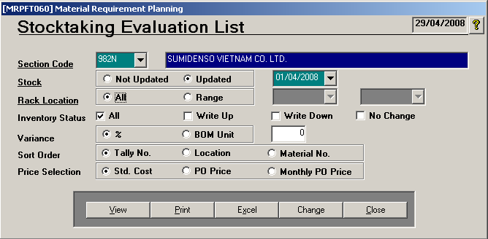
Stock Taking Module………Continue
Click on VIEW button to see the Stocktaking Evaluation List Report

Slide 37
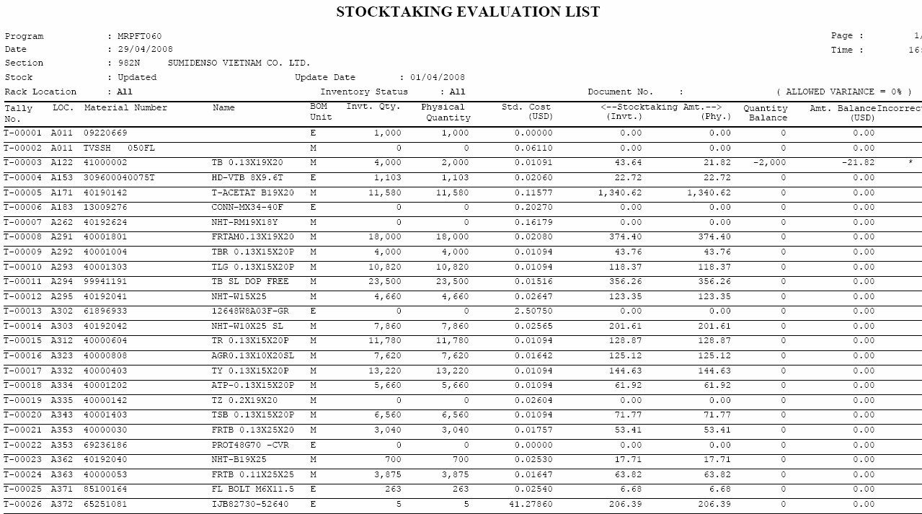

Slide 38
MIS & FINANCE Module
Reporting Modules
MIS for Lower – Middle Management.
Finance – Purchase, Finance & Accounts Dept.
Few reports to mention are: Material Transaction List enlisting material transactions made between given date range, Materials present on Single Assembly Line, Stock Analysis Summary report.
Over 31 Reports.

Slide 39
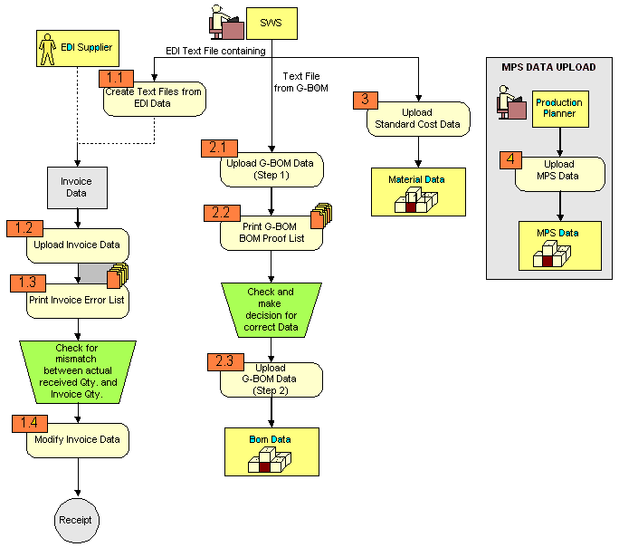
EDI Module
EDI Module is used to Upload EDI Data from Various other
system into GMCS. It includes Invoice and BOM Data.
EDI FLOW

Slide 40
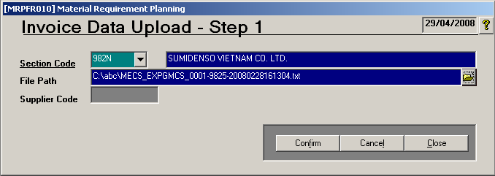
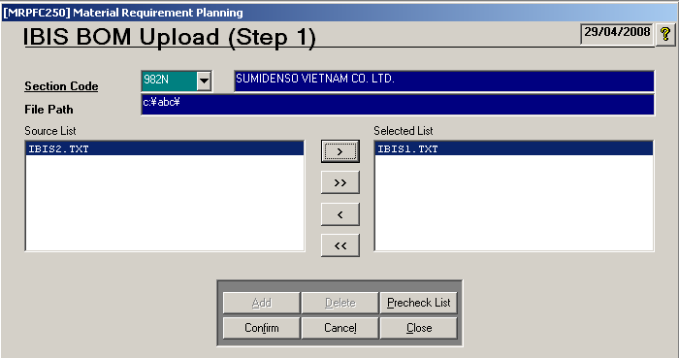
EDI Module ……….Continue

Slide 41
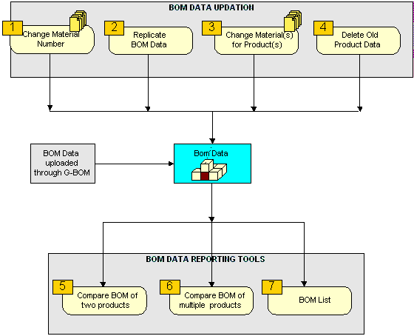
BOM Module
BOM Module is used to perform Various function on BOM Data like BOM Data replication for another product, BOM Material no change, BOM Comparison
BOM FLOW

Slide 42
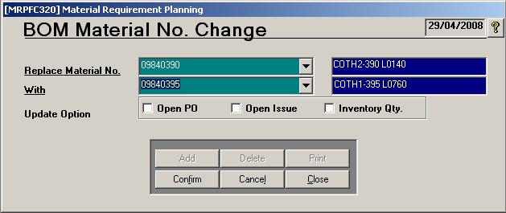
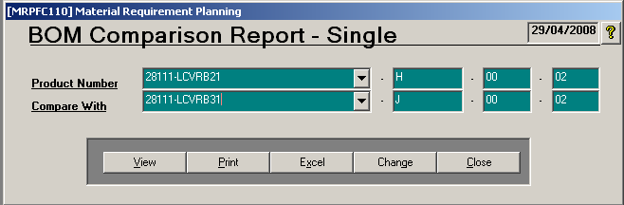
BOM Module ………Continue

Slide 43
Interface With Other Systems
Central Purchase Database – Text file creation for Exporting PO Details.
C&C – Text file import for C&C WIP information.
Common Transfer System – Database to Database interaction, for defining and running schedules.
Common Database (PPS) – Text File and Remote Server interaction for receiving MPS & Stock-IN information, and providing Issue Results.

Slide 44
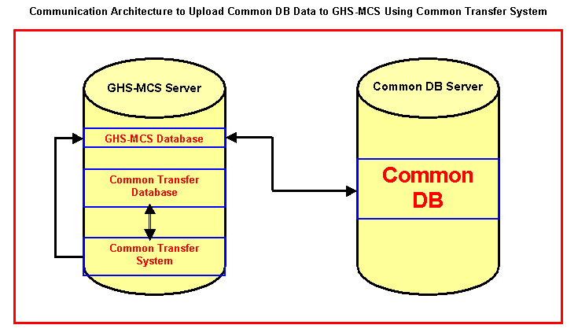
System Setup GMCS - Common DB (PPS)

Slide 45
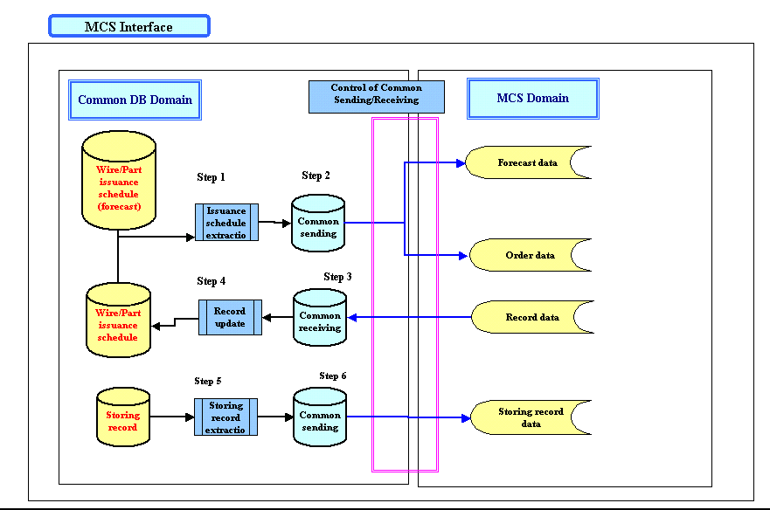
Information Flow GMCS - Common DB (PPS)

Slide 46
Global Implementation
FJK China HZSW China
HZR China HKWS Hong Kong
SDM-S China SDM-M China
HZC China SDMHZ China
WHSW China
FZWS China TJWS China
JXWS China CQWS China
SEWS-SA SEWS-H Hungary
SHWS Vietnam IWSP Philippines
PKI Philippines SBI Indonesia
SIWS Indonesia JKWH Malaysia
SEWT Thailand SCWS Cambodia
SPWS Philippines SDVN Vietnam SVWS Vietnam

Slide 47
GMCS Tangible & Intangible Benefits..
Tangible benefits:
  Inventory reduction
  Personnel reduction
  Improved productivity
  Cost reductions
  Increased revenues
  Delivery improvement
  Order management
  Reduction in maintenance
Intangible benefits:
  Visibility of information
  Improved processes
  Better customer service
  Standardization
  Flexibility
  Globalization
  Improved employee satisfaction
  Increased business performance

Slide 48
Thank You

